Slide 1
Mid-Term Assessment of NSF Progress on the 2015 Strategic Vision for Antarctic and Southern Ocean Research Priority 2 Community Input Session January 8, 2021

Slide 2
Today’s Agenda
2:00 p.m. EST Welcome
Overview of NASEM study
Meeting objectives
Oscar Schofield
Bill Detrich
2:10 p.m. EST Structured input/discussion
Bill Detrich
Ken Halanych
Alison Murray
3:30 p.m. EST Adjourn

Slide 3
2015 Academies Report
NSF should continue to support a core program of broad-based, investigator-driven research.
NSF should pursue the following as strategic priorities in Antarctic and Southern Ocean research for the coming decade:
How fast and by how much will sea level rise? The Changing Antarctic Ice Sheets Initiative
How do Antarctic biota evolve and adapt to the changing environment? Decoding the genomic and transcriptomic bases of biological adaptation and response across Antarctic organisms and ecosystems.
How did the universe begin and what are the underlying physical laws that govern its evolution and ultimate fate? A next-generation cosmic microwave background program.

Slide 4
5 years later, NSF asked the Academies to:
Assess progress in addressing research goals outlined in the 2015 report
Identify significant recent advances in scientific understanding and/or technical capabilities that present important new opportunities for progress in addressing the mission of NSF’s Antarctic Sciences Section.
For the three priority research topics:
Address any current implementation challenges in advancing these research areas.
Suggest strategies to overcome these implementation challenges
Report due in July 2021.

Slide 5
Committee
OSCAR M. E. SCHOFIELD, chair, Rutgers University
AMY BARGER, University of Wisconsin, Madison
KELLY BRUNT, University of Maryland and NASA Goddard Space Flight Center
ROBERT CLAUER, Virginia Tech
INDRANI DAS, Columbia University
WILLIAM DETRICH, Northeastern University
MICHAEL GOOSEFF, University of Colorado, Boulder
KENNETH M. HALANYCH, Auburn University
MARK HALPERN, University of British Columbia
ALISON MURRAY, Desert Research Institute
ERIC RIGNOT, University of California, Irvine
AMELIA SHEVENELL, University of South Florida
HELIO TAKAI, Pratt Institute
TERRY WILSON, Ohio State University
ERIC WOLFF, University of Cambridge

Slide 6
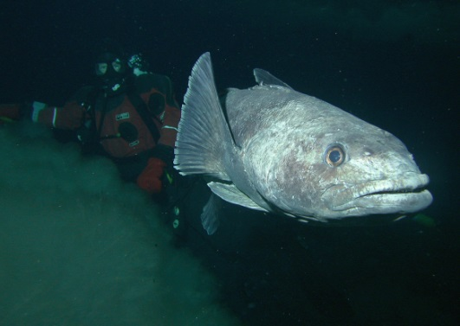
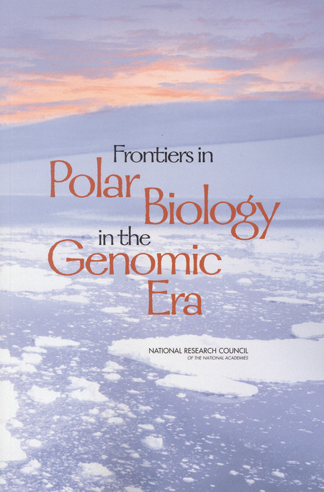
Strategic Priority II. How do Antarctic biota evolve and adapt to the changing environment? Decoding the genomic and transcriptomic bases of biological adaptation and response across Antarctic organisms and ecosystems.
Recent advances in capabilities for decoding genomes and transcriptomes of key species, as well as metagenomes and metatranscriptomes of species assemblages, present new opportunities to advance our understanding of Antarctica’s biological diversity, and species’ adaptive potential to face new environmental challenges.
Proposed: stimulate coordinated efforts among:
-lab-based genomic analyses (existing samples)
-collection of new biological samples
-field-based investigations to study hypotheses
developed through lab studies
Could encompass Antarctic and Southern Ocean life,
ranging from marine mammals to ancient DNA, viruses,
Bacteria, with focus on organisms/communities
important for understanding past and current adaptation.

Slide 7
Meeting Guidelines
Input via polls, chat, and discussion
Raise Zoom hand to talk (Depending on Zoom Version, located under reactions or in participants panel.)
Please keep spoken comments short, don’t repeat what has been said
Use chat to support comments made by others or to provide more input
Additional comments can be provided via a follow-up survey (to be sent after event; can be anonymous)
Meeting is being recorded for committee use only

Slide 8
Evaluation of Implementation—1a
When and how did you first hear about NSF’s goal of understanding adaptation in the Antarctic using –omics technologies?

Slide 9
Evaluation of Implementation—1b
Has NSF sufficiently encouraged proposals from PIs using -omics to understand adaptation and evolution?

Slide 10
Evaluation of Implementation--1c
Is Priority 2 sufficiently well defined in the “dear colleague” letter and annual program solicitations to encourage proposals from PIs using ‘omics to understand adaptation and evolution?

Slide 11
Evaluation of Implementation—1d
What were the opportunities and barriers in the last 5 years to pursuing research in this priority area?

Slide 12
Progress toward Objectives—2a
What are the key NSF-funded scientific successes in this research priority since 2015?

Slide 13
Opportunities for Improving Progress—3a
What are the fundamental research questions and tools that NSF should be funding to advance this research priority?

Slide 14
Opportunities for Improving Progress—3b
Should NSF solicit ‘omics proposals that are discovery- or resource-based in addition to hypothesis-driven to advance the community?

Slide 15
Opportunities for Improving Progress—3c
Emerging science: Are there significant recent scientific and/or technical advances that present important new opportunities for progress?

Slide 16
Opportunities for Improving Progress—3d
Funding Model: Would priority 2 advances be best served with a coherent, targeted initiative vs. PI-driven research?

Slide 17
Opportunities for Improving Progress—3e
Collaboration: What opportunities could be created to bring researchers in this field together to advance the research goals?

Slide 18
Opportunities for Improving Progress—3f
What are the fundamental impediments that NSF should target to advance this research priority?

